Slide 1
FIND TRAVEL PLAN INSURANCE FOR STUDENTS
Team members id Team members
910649 Nithya shree balakrishnan(lead)
910654 Karthikeyan rajan
910602 Lekha martina gananaprakasam
910647 Nithisha pappusamy
910643 Prakash palanisamy

Slide 2
CONTENTS
Problem Statement and Detailed Description
Landing page of policy Bazaar
Travel Insurance Page
Car Insurance Page
Health Insurance Page
Test Data
Output from Console
Report
Functional Test cases

Slide 3
Problem Statement : 1) Display three lowest international travel insurance plan with amount and insurance provider company 2) Group of 2 student people (Age 22,21) 3) For any European country. (Suggested Site: policybazaar.com however you are free to use any other legitimate site) Detailed Description: 1) Find travel insurance plan for students, for 2 people (Age 22 & 21) & any European country, fill further dummy details & display three lowest international travel insurance plan with amount and insurance provider company 2) Get a Car Insurance quote, proceed without car number, keep filling details, give invalid email or phone number & capture the error message 3) Retrieve all Health Insurance menu items and store in a List; Display the same

Slide 4






Website we used https://www.policybazaar.com/
Tools and Software’s used:

Slide 5
WORK DONE
The code is written in JAVA language and then is further automated using Selenium.
Data obtained from website is stored in Excel Sheet using Apache POI; also, data input is taken from a file with variables written in it.

Slide 6
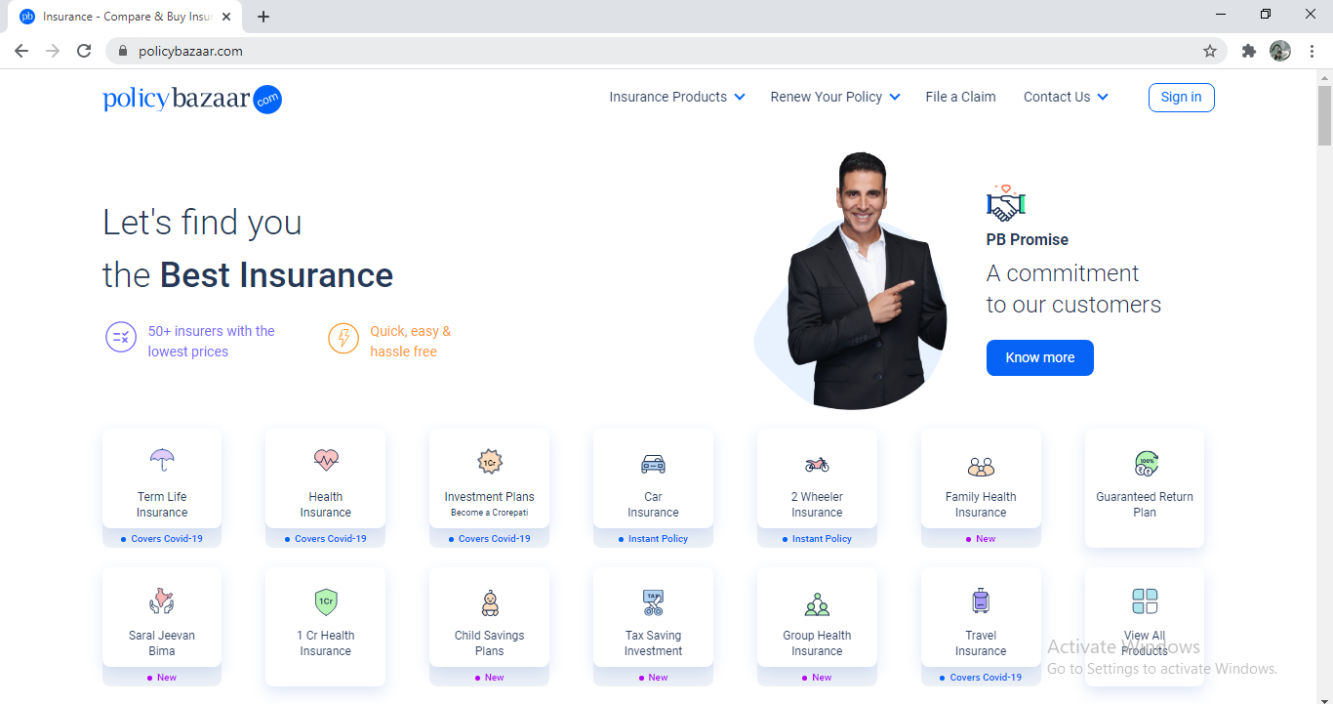
LANDING PAGE OF POLIZY BAZAAR

Slide 7
Work flow to find Three Lowest Travel Insurance Plans:
Launch Browser
Fill all the details(Destination, Age, Trip dates etc)
Open PolicyBazaar.com
Click on Get Free quotes
Open Travel Insurance
Select Low to High in Sort By Option
Select Student Phase
Display Three Lowest International Travel Insurance plans

Slide 8
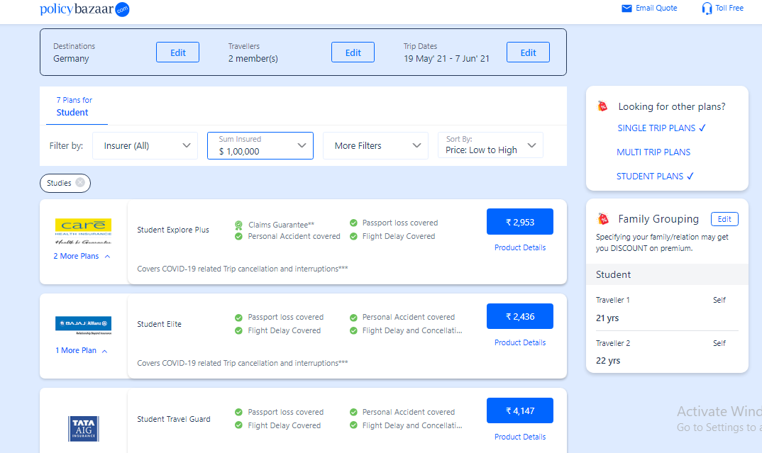
THREE LOWEST TRAVEL INSURANCE PLAN

Slide 9
Work flow for Car Insurance
Launch Browser
Fill all the Details
Open PolicyBazaar.com
Invalid Email or Phone number should be given
Open Car Insurance
Capture the Error Message
Click on Proceed without Car Number

Slide 10
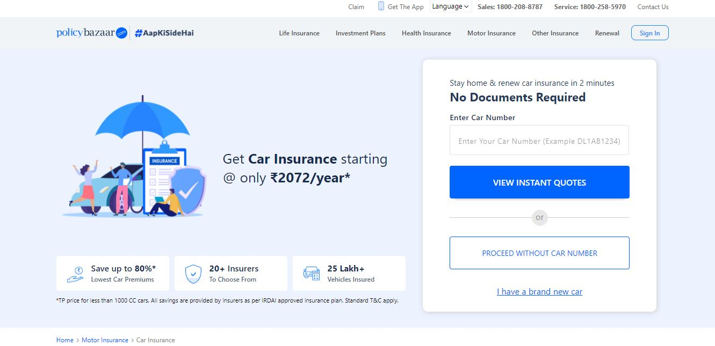
CAR INSURANCE

Slide 11
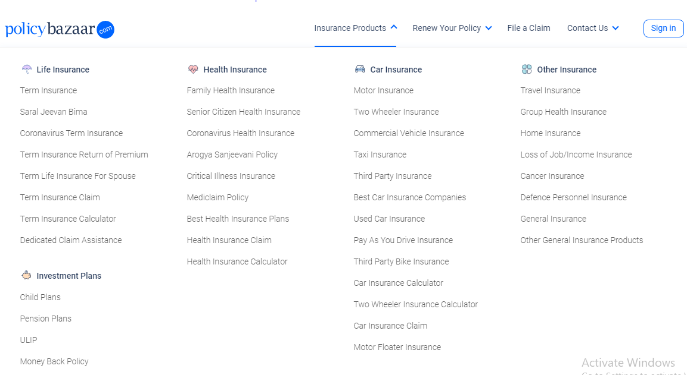
HEALTH INSURANCE

Slide 12
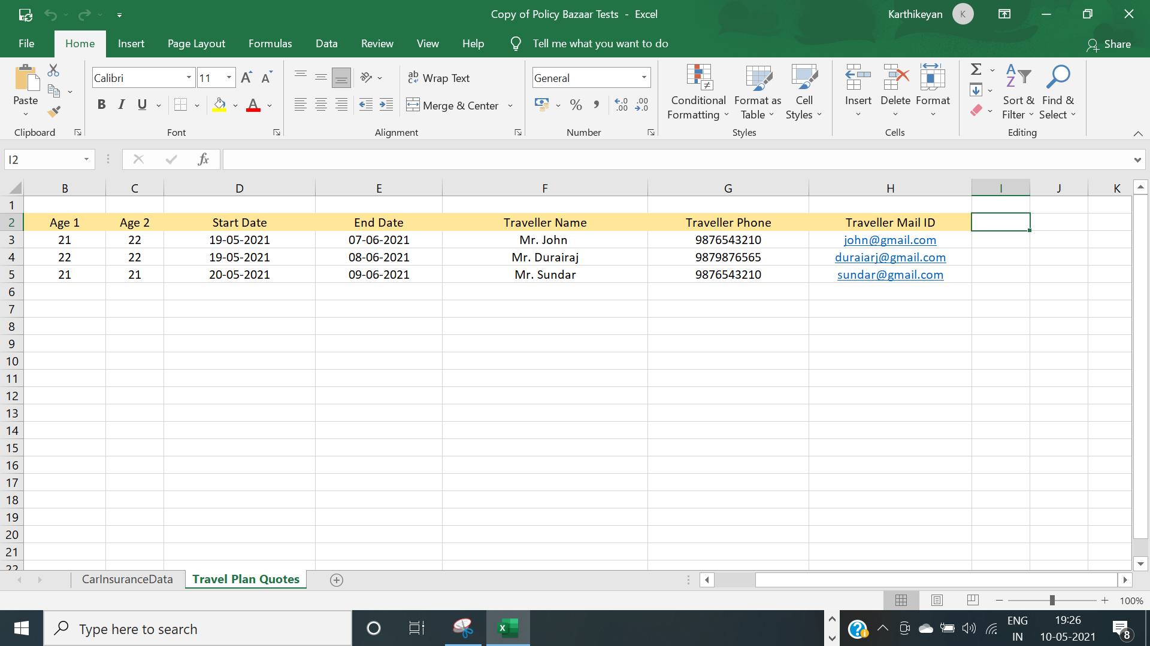
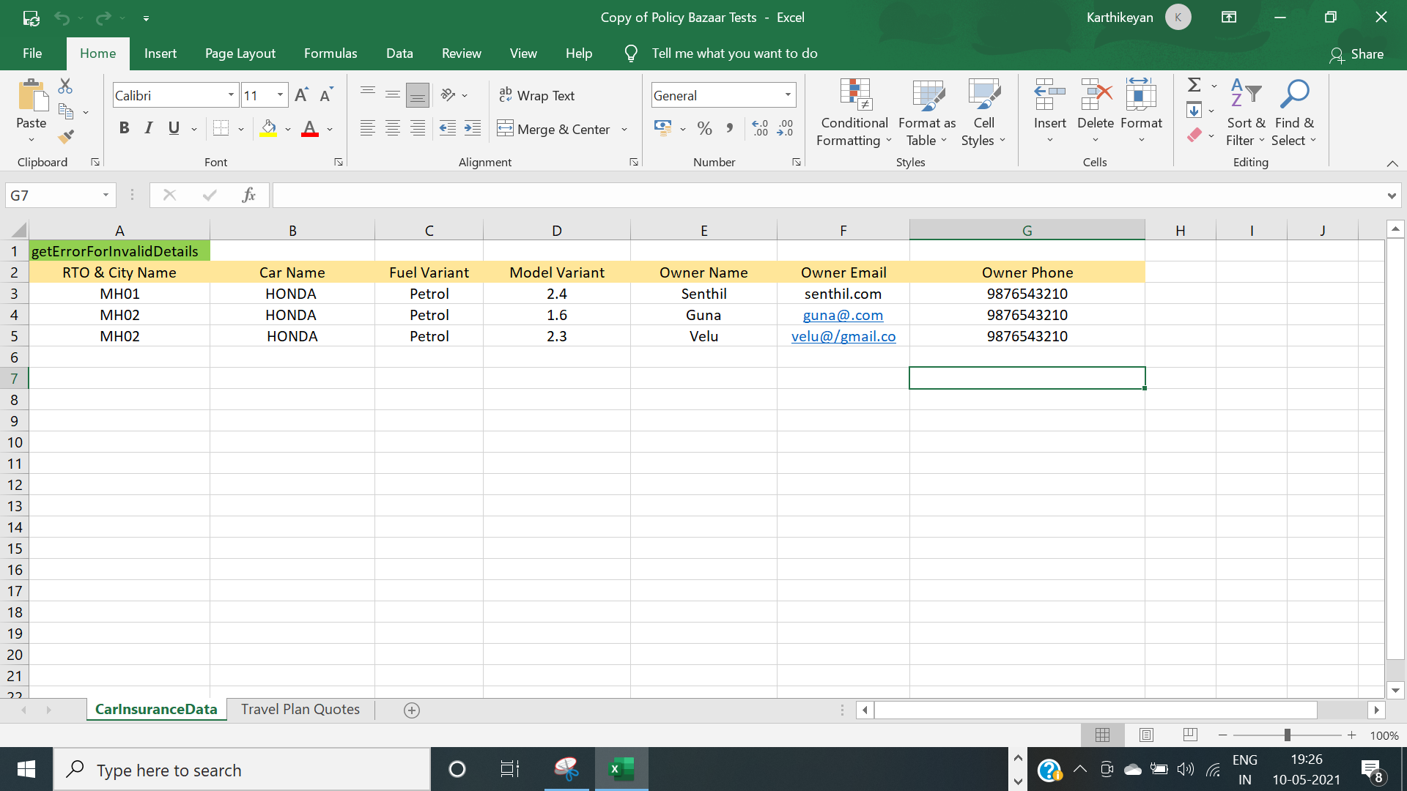
TEST DATA

Slide 13
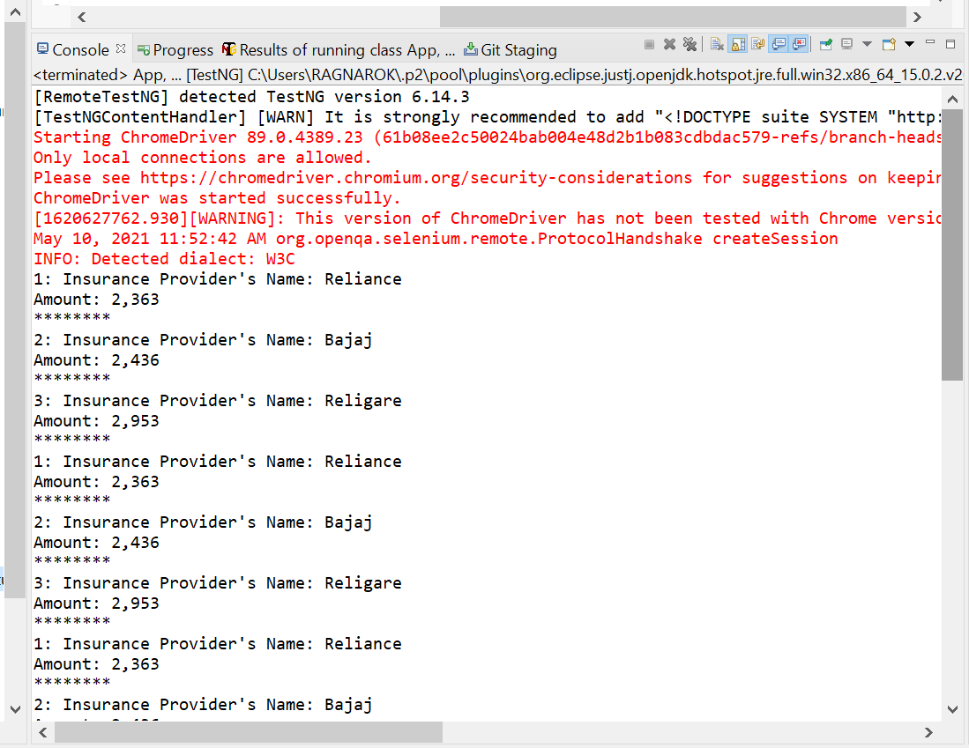
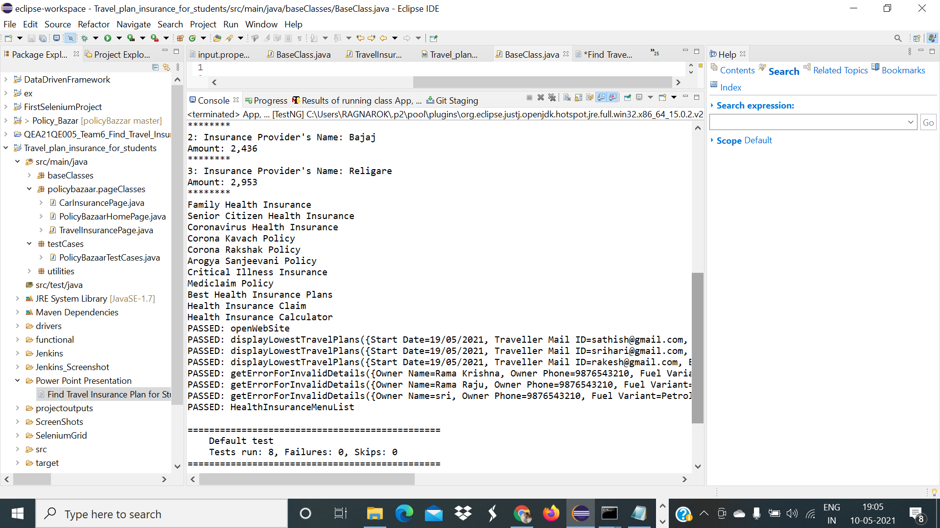
OUTPUT FROM CONSOLE

Slide 14
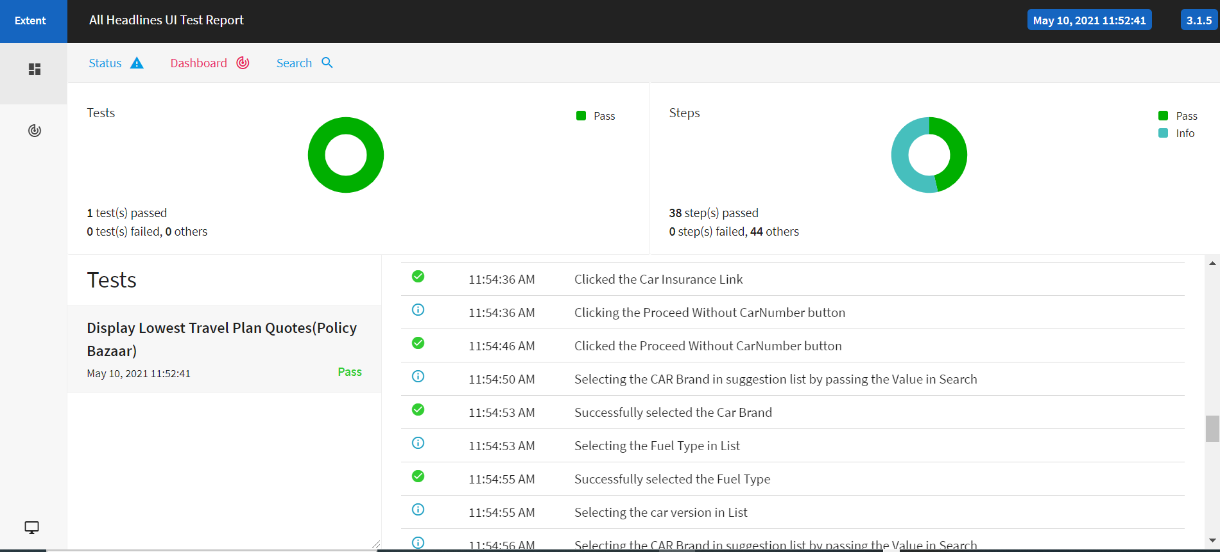
REPORT

Slide 15
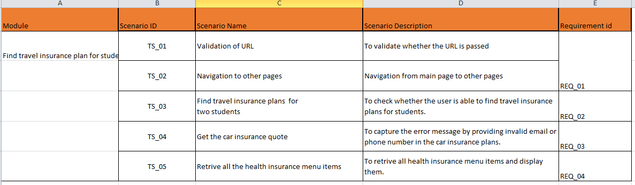
FUNCTIONAL TEST CASES

Slide 16
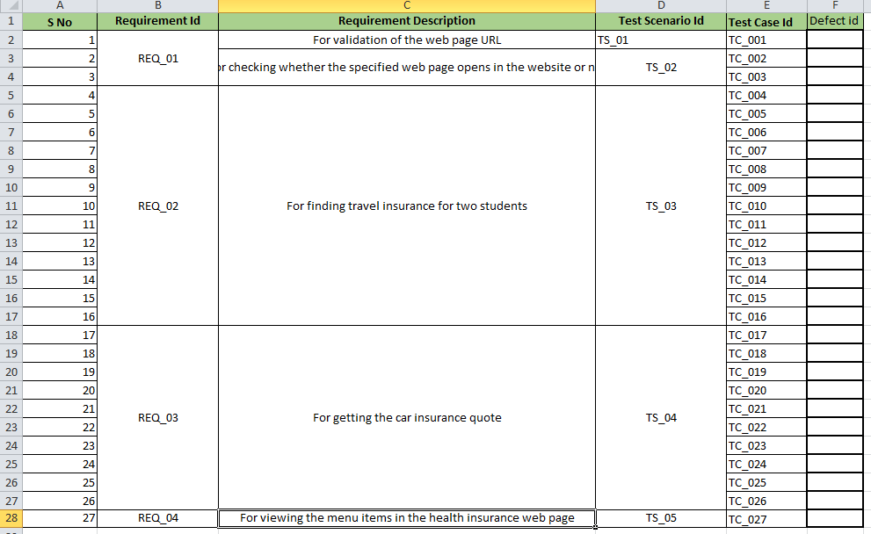

Slide 17


